Slide 1
Brallie –I
ID1035: Independent Project
Project ID : 2019ID103515

Slide 2
Objective
Create a device to cater the need of the specially abled people.
Understand the working of various components used in the making of the model.
To be able to create a device which would convert the given text into speech which would serve as the voice of the mute people.

Slide 3
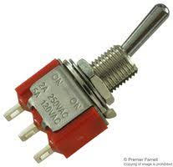
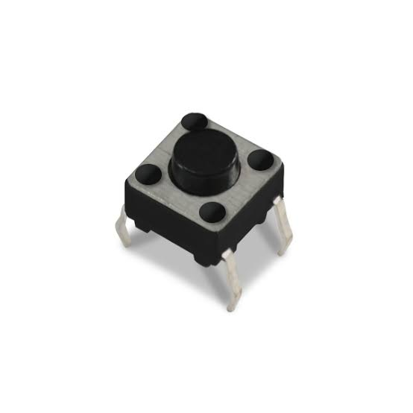
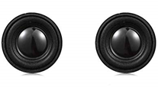
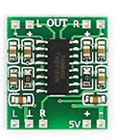
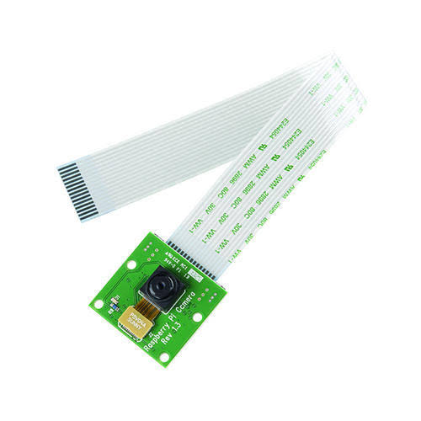
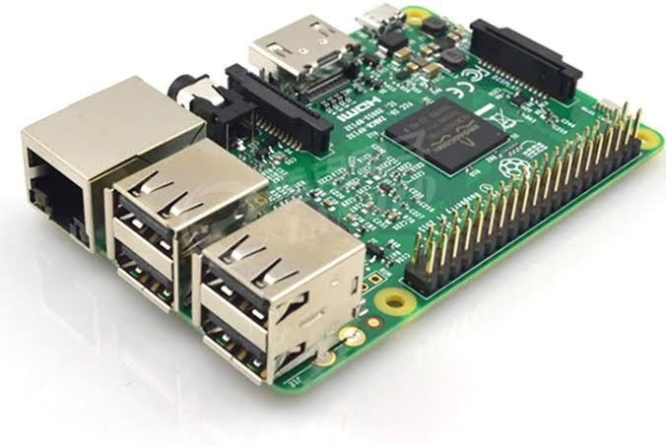
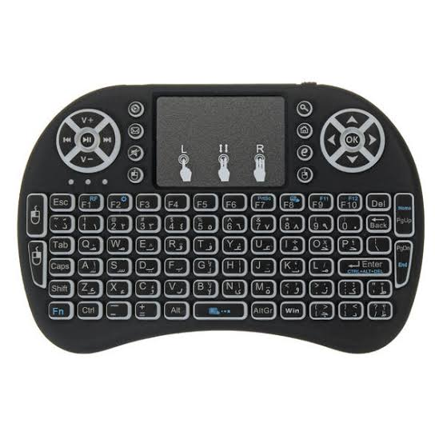
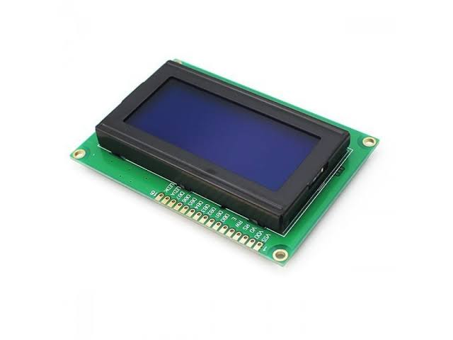
Components Used
Toggle Switch
Reset Switch
Speakers
Mini Amplifier (PAM 8403)
Raspberry Pi Cam
Raspberry Pi 3B
Mini Keyboard
Single Line LCD (20x4)

Slide 4
PYTHON MODULES AND API’S USED
Tesseract from google is used to text scanning mode as an OCR (Optical Character Recognition).
Espeak is a TTS (Text To Speech) engine used to both the modes to speak out the input given.
Rpio.GPIO is used to configure the toggle switch and the reset switch
Subprocess is used to write the commands into the Ubuntu shell for the modules Espeak and Tesseract
I2C_LCD_DRIVER is used to display characters over the vibrant LCD display.

Slide 5
Basic Working
The text to speech (TTS) system is often known as speech synthesis.
It usually consist of two parts:
First it takes the raw text and convert letters, numbers etc into their written out word equivalents. This process is often called text normalization, processing , or tokenization.
Then it assigns phonetic transcriptions to each word, and divides and marks the text into various linguistic units like phrases, clauses, and sentences.
In second it takes the symbolic linguistic representation and converts it into actual sound output.

Slide 6
Disadvantages of conventional braille SCRIPT
Errors can not be erased.
Non availability of each type of books.
Not possible to make articles, newspapers etc.
Can not be read by a sighted person who has not learned it.

Slide 7
Our modified braille’s advantage
It is a flexible type of system in which the input can be altered as when needed. Hence the errors can be erased.
As we are attaching a camera to scan the text, separate books need not be printed for the blind people.
Can be read by a sighted person who has not learned the conventional BRAILLE SCRIPT.

Slide 8
Text input mode
It would help those who cannot speak.
The mute person has to just type in message he/she wishes to convey using the keyboard provided.
The software , as described in working, would normalize the text and give a speech output.

Slide 9
Text scanning mode
This mode is helpful for those who cannot see.
The person should bring the text which he/she wishes to convert and place it on the stand provided.
The Pi cam attached will scan the text and the software would convert it into speech and thereby serving its purpose.

Slide 10
Thank You!!
Project made by:
Aman Pratap Singh - CH19BTECH11009
Anirudh Raghav – CH19BTECH11033
Chirag Jain – EE19BTECH11047
Dumpa Vinesh Reddy – AI19BTECH11023
Kashish Pethani – ME19BTECH11003
Vaibhav Gupta – CH19BTECH11030

